Slide 1
LAKE CONFERENCE 2022
Birds of Hommadevanahalli.
Team
Santhosh R – class 8

Slide 2
INTRODUCTION:
Birds are recognized as one of the most important indicators
of the environment. Because they are sensitive to habitat change
Bird populations are the first indication of environmental problems.
They play a vital role in controlling pests, acting as pollinators;
as serving as a source of food and providing fertilizer in agriculture
We rely on them for pest control.

Slide 3
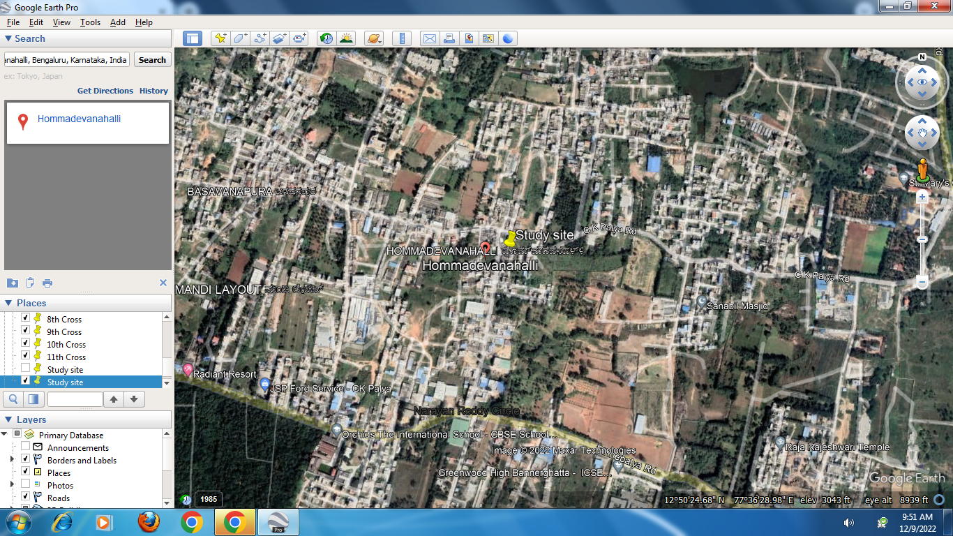
Objective:
To Document Birds of Hommadevanahalli
Study Area: MAP
N

Slide 4
Study SITE:
12º50’40”N 77º35’53”E
Dinnepalya in Hommadevanahalli.
Study Area:
Hommadevanahalli, Begur ward,
Bangalore south.

Slide 5
Methods and materials:
We visited Weekly twice, Sunday and Wednesday from August to October.
In-between 6.00 am to 6-30am and Evening 5.30 pm to 6.00 pm.
Identification of the birds was made by visual method and by hearing the sound of the birds.
We used Pakshi app for identifying the sounds of the birds.
iNaturalist for identifying Birds.

Slide 6
Results and Discussion
Totally 12 species of birds were found in the selected site.
Birds found month wise
SL NO | MONTH | SPECIES
1 | August | 10
2 | September | 10
3 | October | 9

Slide 7
Checklist of birds which are documented at Hommadevanahalli
Sl No | Common name | Scientific name | Genus name | Aug | Sept | Oct
1 | White throated kingfisher | Halcyon smyrnensis | Halcyon | 2 | 3 | 1
2 | Black winged kite | Elanoides forficatus | Elanus | 1 | 0 | 2
3 | Common myna | Acridotheres tristis | Typical mynas | 0 | 1 | 0
4 | Oriental magpie robin | Copsychus saularis | Shamas | 1 | 3 | 1
5 | Black rumped. woodpecker | Dinopium benghalense | Dinopium | 3 | 4 | 0
6 | Rose ringed parakeet | Psittaculaa krameri | Rose-ringed Parakeets | 1 | 0 | 1
7 | Red whiskered bul bul | Pycnonotus jocosus | Pycnonotus | 2 | 1 | 2
8 | White browed wagtail | Maderaspatnsis Sp. | Wagtails | 1 | 3 | 0
9 | Green bee eater | Meropidae Sp. | Typical bee-eaters | 0 | 2 | 3
10 | Rock pigeon | Columba livia | Typical pigeons | 1 | 2 | 1
11 | House crow | Corvus splendens | Crows | 4 | 3 | 4
12 | Indian jungle crow | Corvus culminates | Corvus | 3 | 5 | 6

Slide 8
Conclusion:
Birds are a part of the balanced nature.
In our study site Hommadevanahalli totally 12 species of birds were found.
White Throated King fisher, Indian jungle crow, House crow and Black rumped back lesser golden backed woodpecker were found in all the three months of the study.
Rose ringed parakeet, Common myna and Wilsons snipe were found only once in the study.

Slide 9
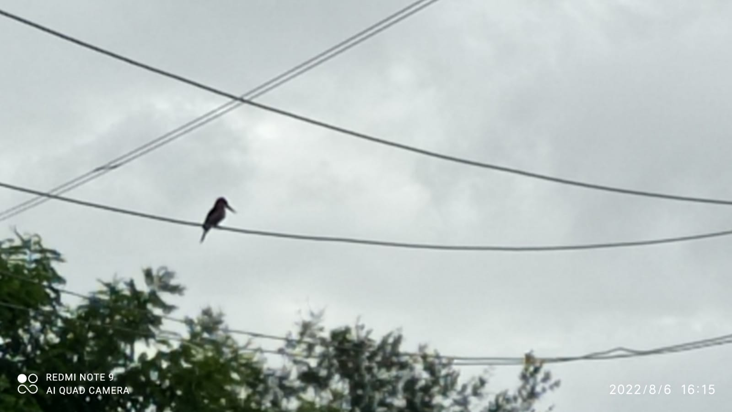
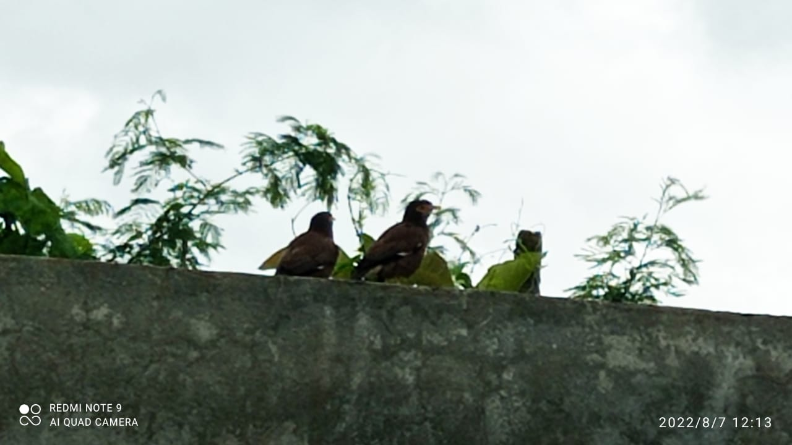
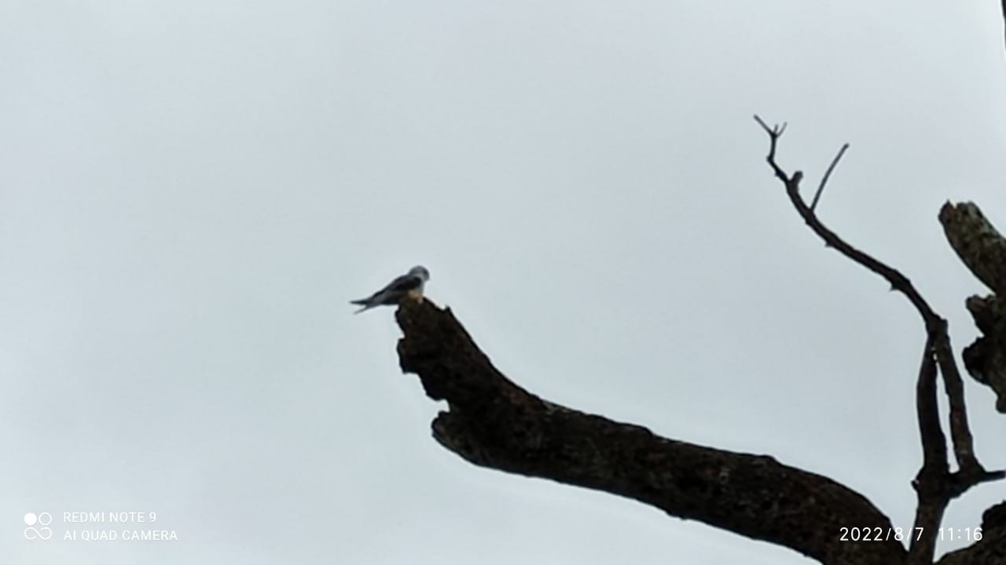
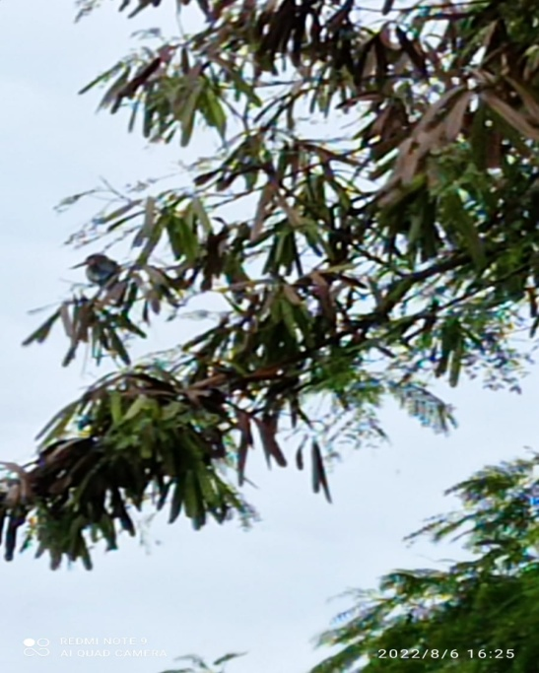
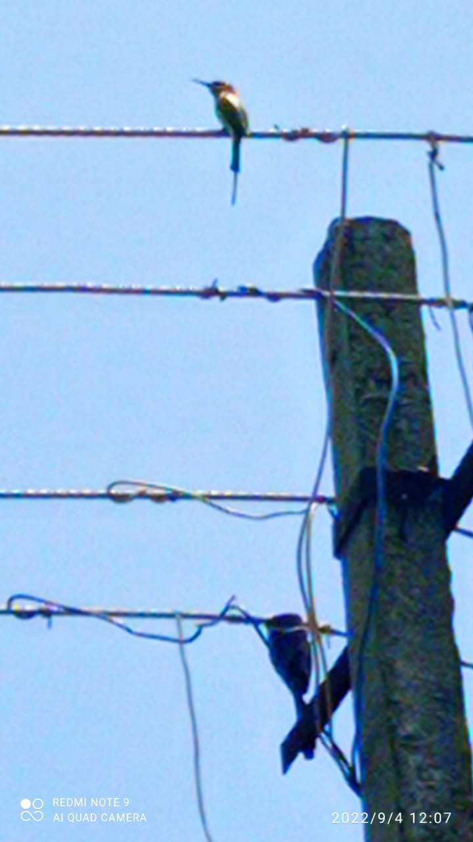
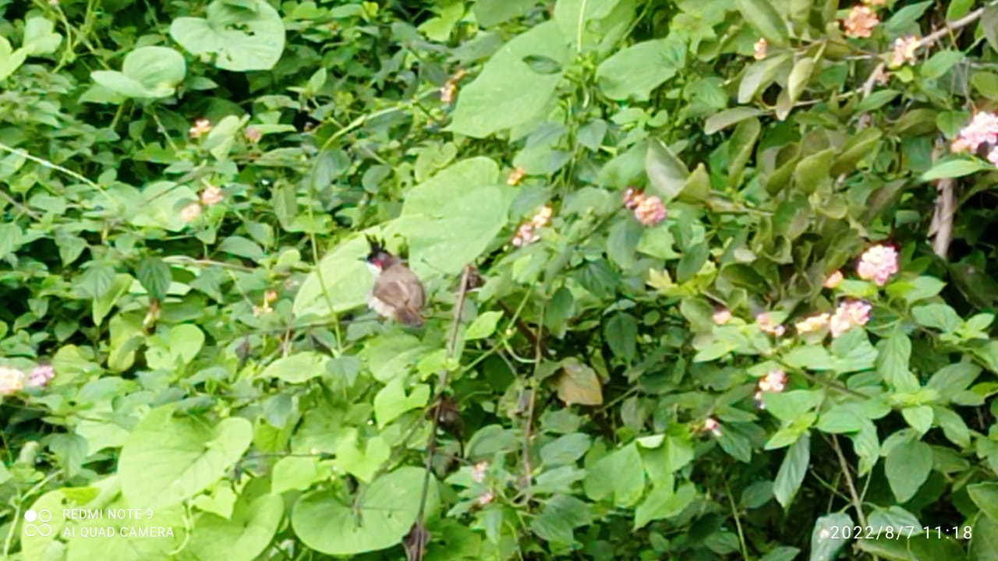
Identified birds:
White throated kingfisher
Common Myna
Black winged Kite
White throated kingfisher
Green bee eater
Red whiskered bulbul

Slide 10
ACKNOWLEDGEMENT
We thank our H.M, Guide Teacher for allowing us to conduct the Study.
We thank Energy and Wetland Research Group, Center for Ecology Sciences, Indian Institute of Science. Bangalore,
Shri Vriju lal of CEE and Shri Chaturved Shet R for guiding and
We thank one and all here for giving us opportunity to present the Study.

Slide 11
REFERENCE:
Harish Bhat et all (2015) A Brochure of Eyes on Nature
published by Karnataka State Council for Science and
Technology.
Pakshi app for identifying the bird sounds.
For scientific name Wikipedia.
iNaturalist for identifying Birds.
100 birds of Bangalore city by Karnataka forest department 2005.

Slide 12
THANK YOU

